Slide 1
Statistics And Probability.
Probability Distributions.

Slide 2
Discrete Random Variables.

Slide 3
Types of Distribution:
Bernoulli Distribution.
Binomial Distribution.
Poisson Distribution.
Uniform Distribution
Geometric Distribution.

Slide 4
Bernoulli Distribution:

Slide 5
Bernoulli Distribution:
Equations:
PMF pX(0)=1−p pX(1)=p
CDF F(x)=p^x*〖(1-p)〗^{(1-x)}

Slide 6
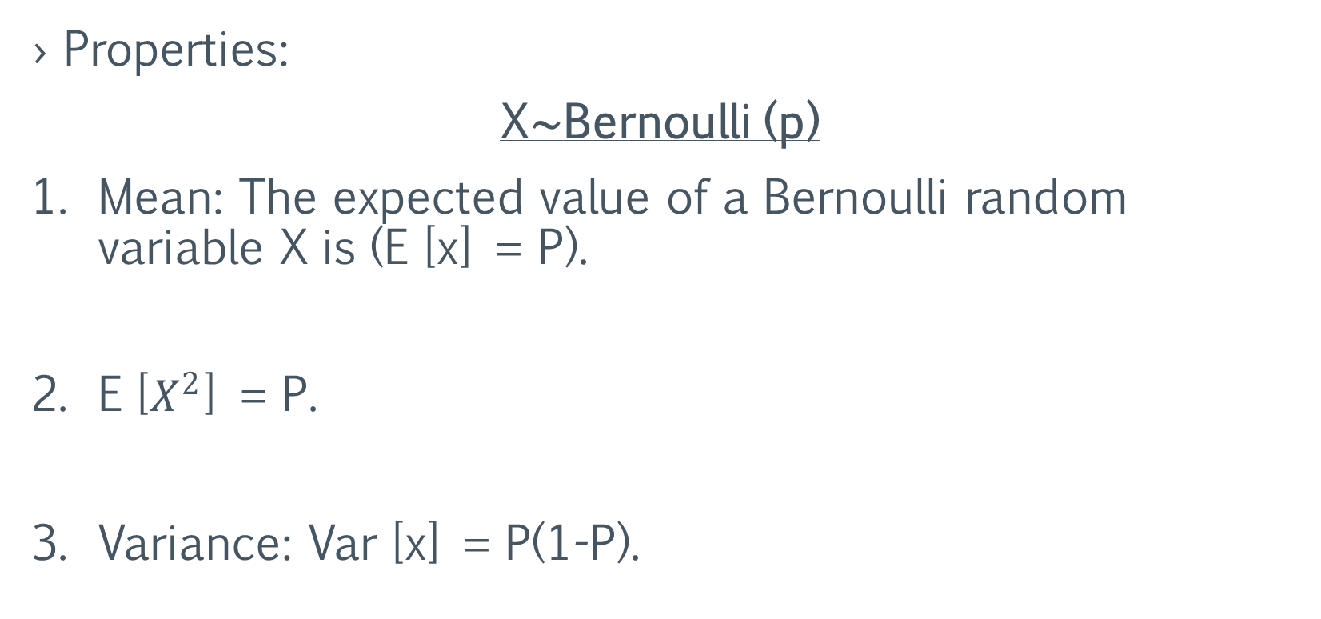
Bernoulli Distribution:
Properties:
X∼Bernoulli (p)
Mean: The expected value of a Bernoulli random variable X is (E [x] = P).
E [$X^{2}$] = P.
Variance: Var [x] = P(1-P).

Slide 7
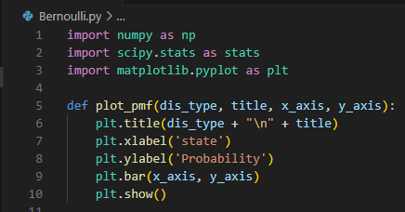

Bernoulli Distribution:
Code:
First, we need to import
needed libraries and define
the plotting:
Second, setting up the
Bernoulli distribution:

Slide 8

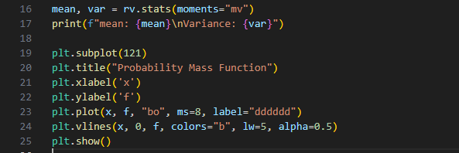
Bernoulli Distribution:
Code:
Third, Defining values
for X (Possible outcomes):
Fourth, calculating probability
mass function (PFM), Mean
and Variance:
Finally, printing mean and
variance also, plotting the PMF:

Slide 9
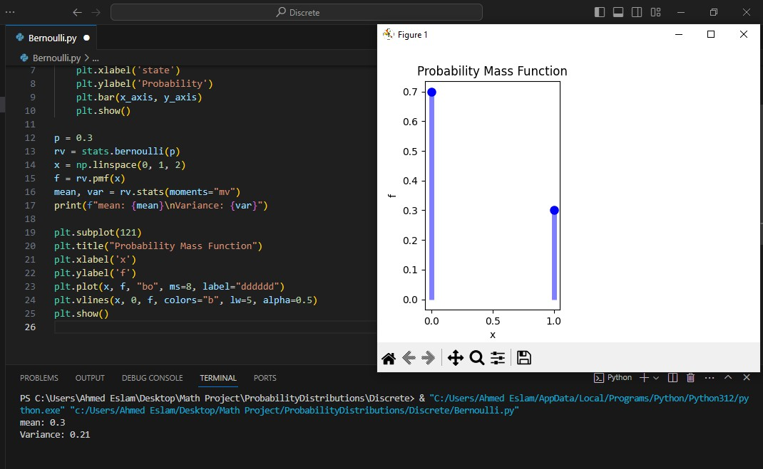
Bernoulli Distribution:
Output:
Mean
and Variance
PMF Plot

Slide 10
Binomial Distribution:

Slide 11


Binomial Distribution:
Equation:
PMF :
Where:
n: is number of trials
p: probability of success in one trial k: number of successes
CDF :

Slide 12
Binomial Distribution:
Properties:
X∼Binomial (n,p)
Mean: the expected value of X is( E[X] =np).
E [X²] = np (np+ (1−p)).
Variance: (Var[X] =np(1−p)).

Slide 13

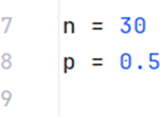
Binomial Distribution:
Code:
First, We start by importing
the necessary libraries:
Second, we set the parameters of the
Binomial Distribution:

Slide 14
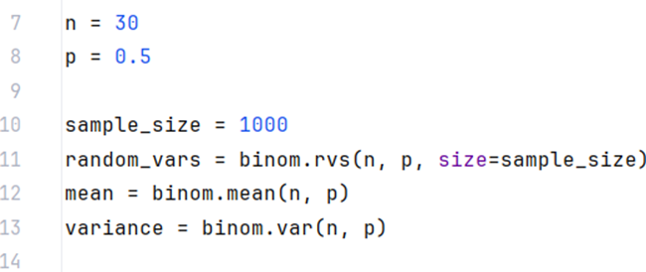

Binomial Distribution:
Code:
Third, we generate the
necessary variables used for
calculating mean and variance:
Finally, We use the following
code to print mean and
variance:

Slide 15
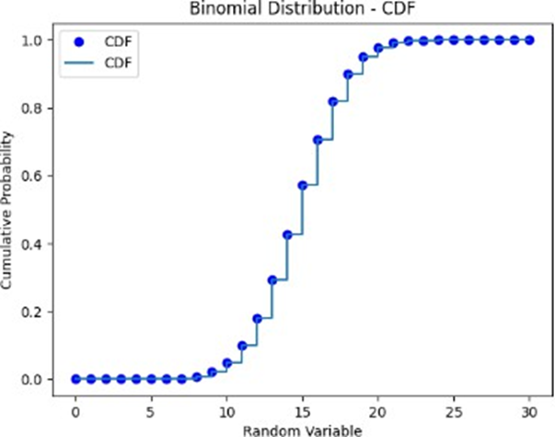
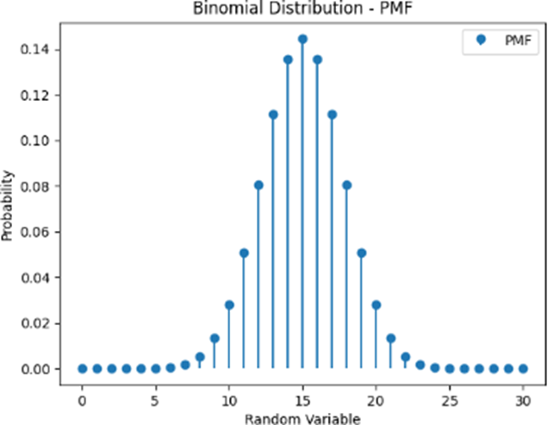
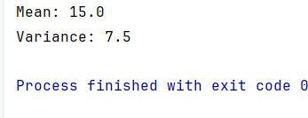
Binomial Distribution:
Output:
Mean
and Variance
PMF Plot
CDF Plot

Slide 16
Poisson Distribution:

Slide 17

Poisson Distribution:
Formula:
Where:
X is a random variable following a Poisson distribution
K is the number of times an event occurs
P (X = k) Is the probability that an event will occur k times
e is Euler’s constant (approximately 2.718)
𝜆 is the average number of times an event occurs
! is the factorial function

Slide 18
Poisson Distribution:
Properties:
X~Poisson (𝜆)
Mean: 𝐸(𝑥) = 𝜆.
𝐸 (〖x 〗²) = 𝜆 + λ².
variance: 𝑉𝑎𝑟 (𝑥) = 𝜆.

Slide 19
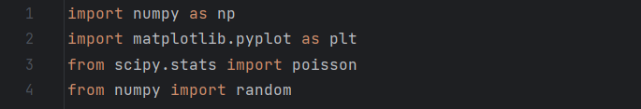
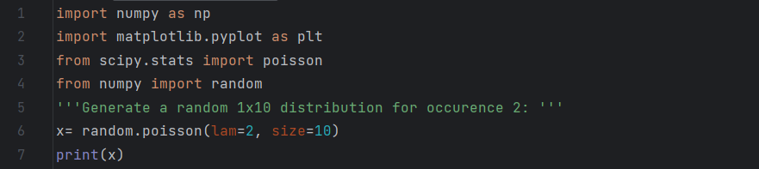
Poisson Distribution:
Code:
First, we start by importing
the required libraries:
Second, the code produces
a different set of random
numbers each time it is
Executed:

Slide 20
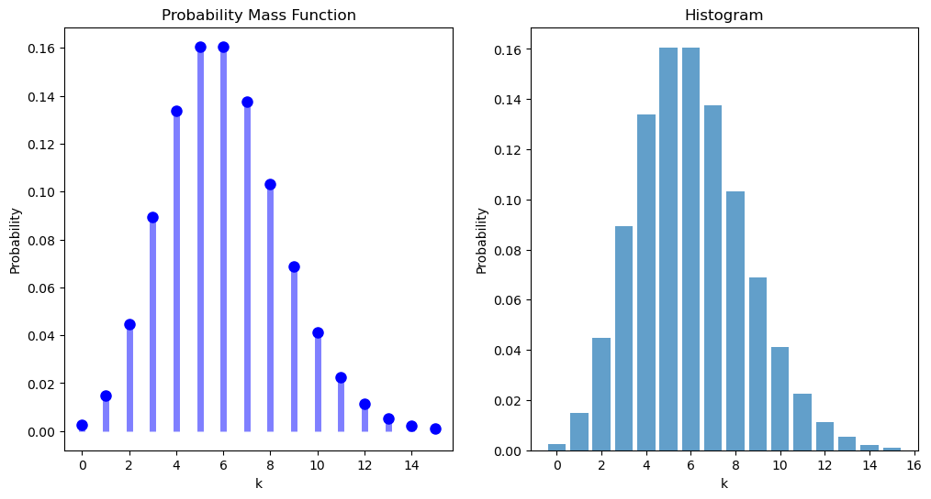
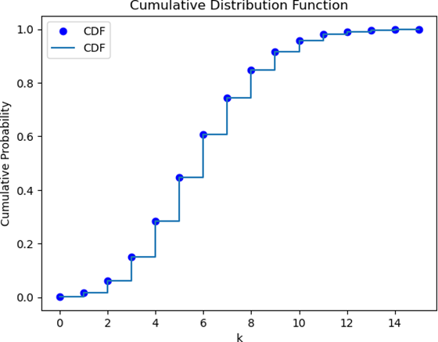
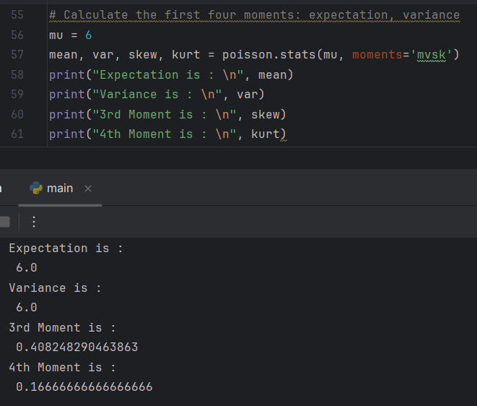
Poisson Distribution:
Output
Four
Moments
PMF Plot
CDF Plot

Slide 21
Uniform Distribution:

Slide 22
Uniform Distribution:
Formula: PMF p(x) = 1 / m, where x=1,2,…,m
Properties:
X~Uniform (m)
Mean: The expected value of a Uniform random variable X is (E[x]= (m+1) /2) .
Variance: Var[x] = (m² - 1) / 12.

Slide 23

Uniform Distribution:
Code:
First, we define the parameters a and b,
which represent the range of values for a
discrete uniform distribution:
Second, this line generates
1000 random samples, These
samples represent the random variable X:

Slide 24

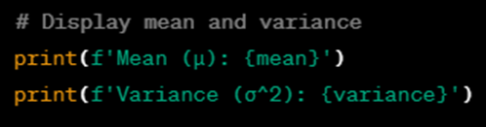

Uniform Distribution:
Code:
Third, this line calculates the mean
and variance of the generated samples:
Fourth, this prints the calculated
mean and variance to the console:
Fifth, this line creates an array of
discrete values for X:

Slide 25

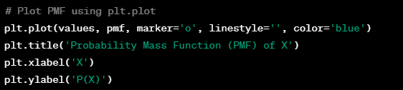
Uniform Distribution:
Code:
Sixth, we calculate the
Probability Mass Function (PMF) for
the discrete values:
Finally, This block of code
plots the PMF using plt.plot:

Slide 26
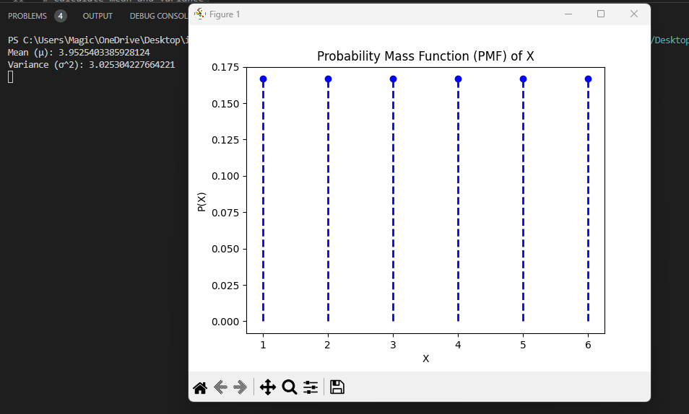
Uniform Distribution:
Output:
PMF Plot

Slide 27
Geometric Distribution:

Slide 28
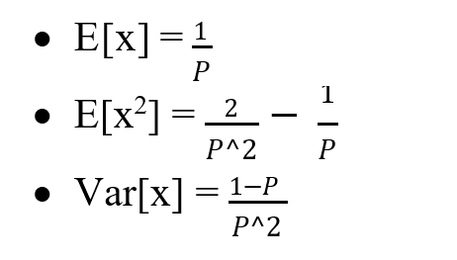
Geometric Distribution:
Formula: Px (k) = (1 – P )^{k-1} P
Properties:
X~Geometric (m)

Slide 29
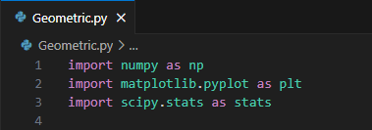
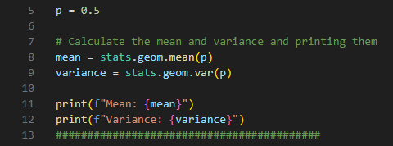

Geometric Distribution:
Code:
First, importing needed libraries:
Second, defining the probability
and calculating Mean and Variance:
Third, creating values for x and
Geometric Distribution:

Slide 30
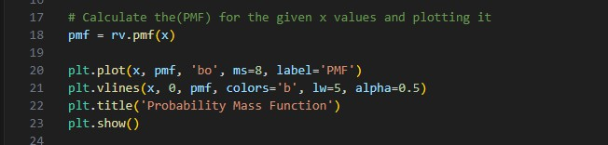
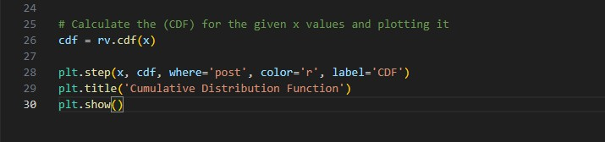
Geometric Distribution:
Code:
Fourth, calculating Probability
mass function for "x"
and plotting it:
Finally, calculating cumulative
density function for "x"
and plotting it

Slide 31
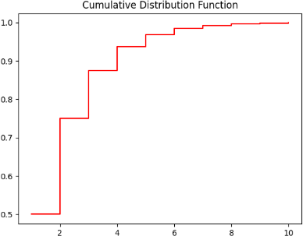
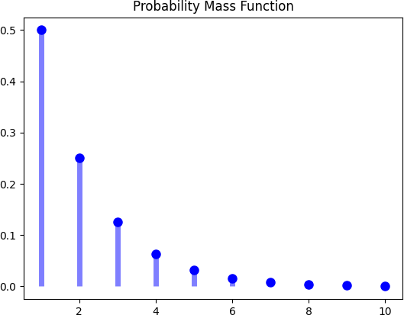
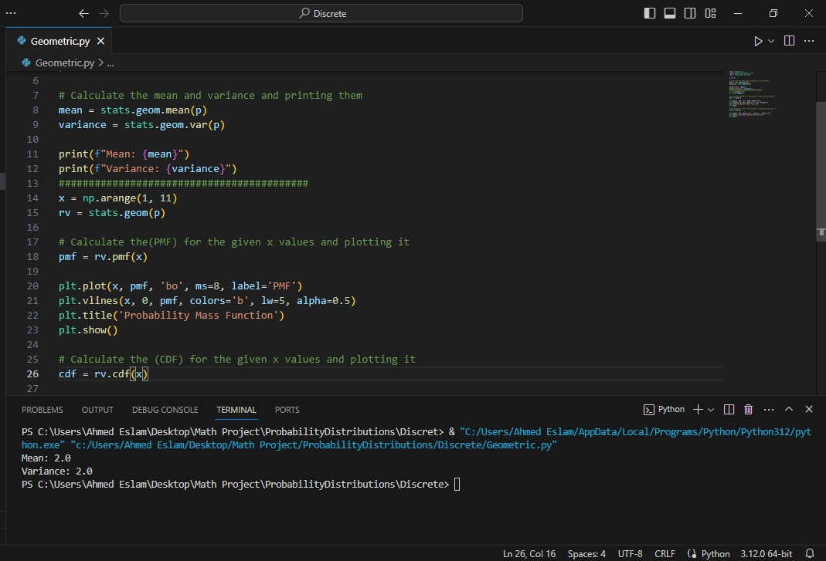
Geometric Distribution:
Output:
Mean
and Variance
PMF Plot
CDF Plot

Slide 32
Continuous Distribution

Slide 33
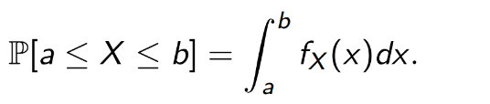
Continuous Distribution:
Formula:
Where:
a : the beginning of interval
b : the end of the interval
fx(x): is the probability density function”PDF”

Slide 34
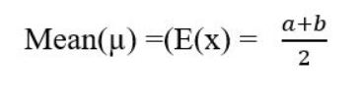

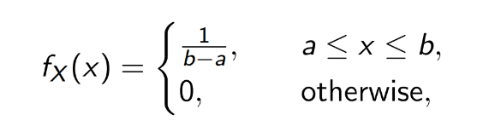
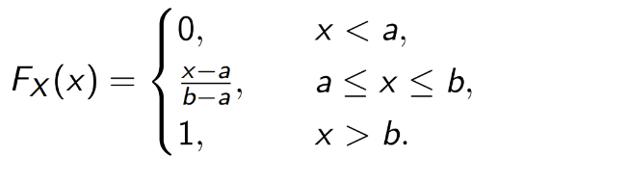
Continuous Distribution:
Properties:
X∼Continuous (p)
PDF :
CDF :

Slide 35

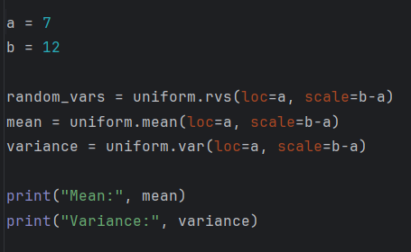
Continuous Distribution:
Code:
First we import the libraries we
need for executing the code :
Second, this block calculates
and plots the uniform distribution
using the two parameters a and b:

Slide 36
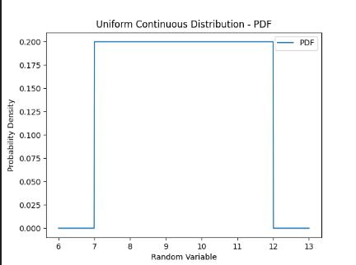
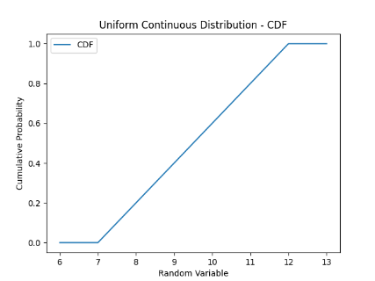
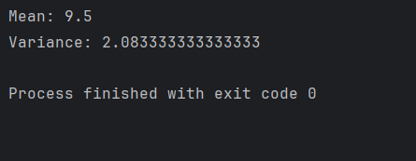
Continuous Distribution:
Output:
Mean
and Variance
PDF Plot
CDF Plot

Slide 37
Exponential Distribution

Slide 38

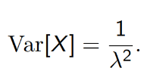
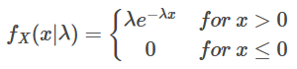
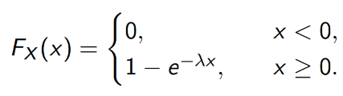
Exponential Distribution:
Properties:
X∼Exponential (𝜆)
Mean :
Variance :
PDF :
CDF :

Slide 39
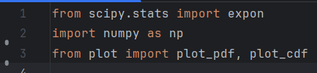
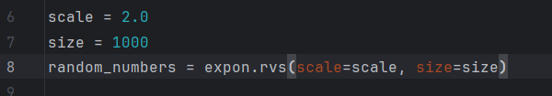
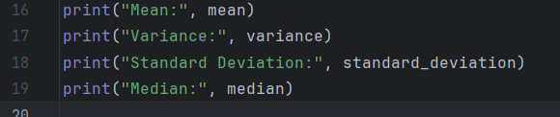
Exponential Distribution:
Code:
First, this code imports the
necessary libraries and modules:
Second, we set Random
numbers it’s size 1000:
Third, we calculate mean,
variance, standard deviation
and median:

Slide 40
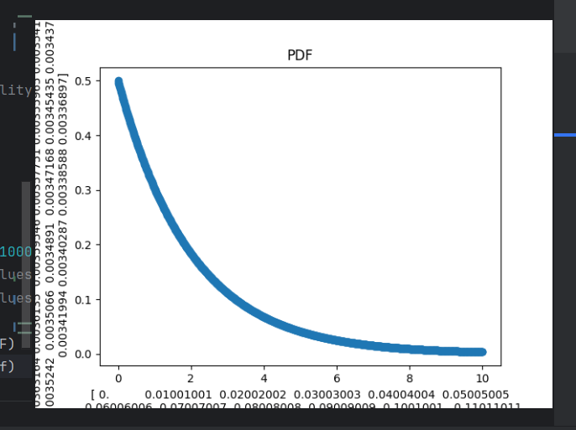
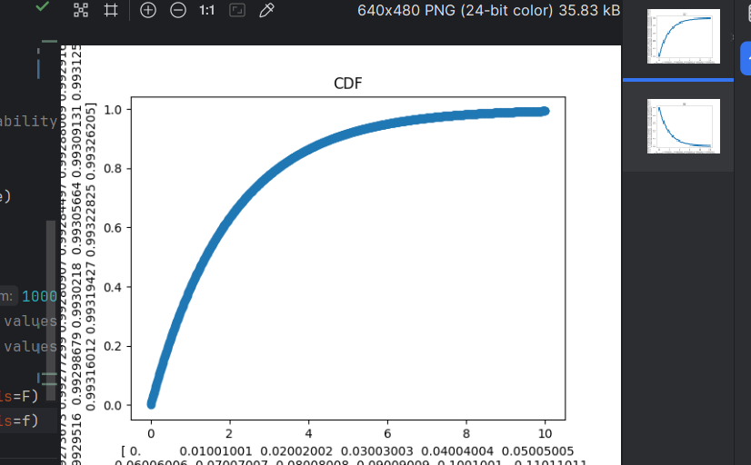
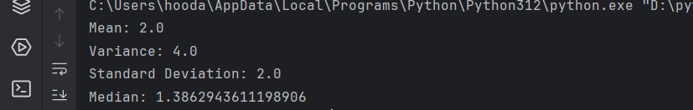
Exponential Distribution:
Output:
Mean
and Variance
and Standard Deviation
and Median
PDF Plot
CDF Plot

Slide 41
Gaussian Distribution

Slide 42

Gaussian Distribution:
Properties:
X∼Exponential (𝜆)
PDF : P(x) = $\frac{1}{\begin{aligned}\sqrt{2πσ^{2}}\end{aligned}} e^{\frac{\begin{aligned}−{\left(x−μ\right)}^{2}\end{aligned}}{2σ^{2}}}$
Where ($μ, σ^{2}$) are parameters of the distribution
CDF : Φ(x) = F_{x}(x) = $\frac{1}{√2π} \int_{−∞}^{x}{e^{\frac{\begin{aligned}−t^{2}\end{aligned}}{2}}}dt$

Slide 43
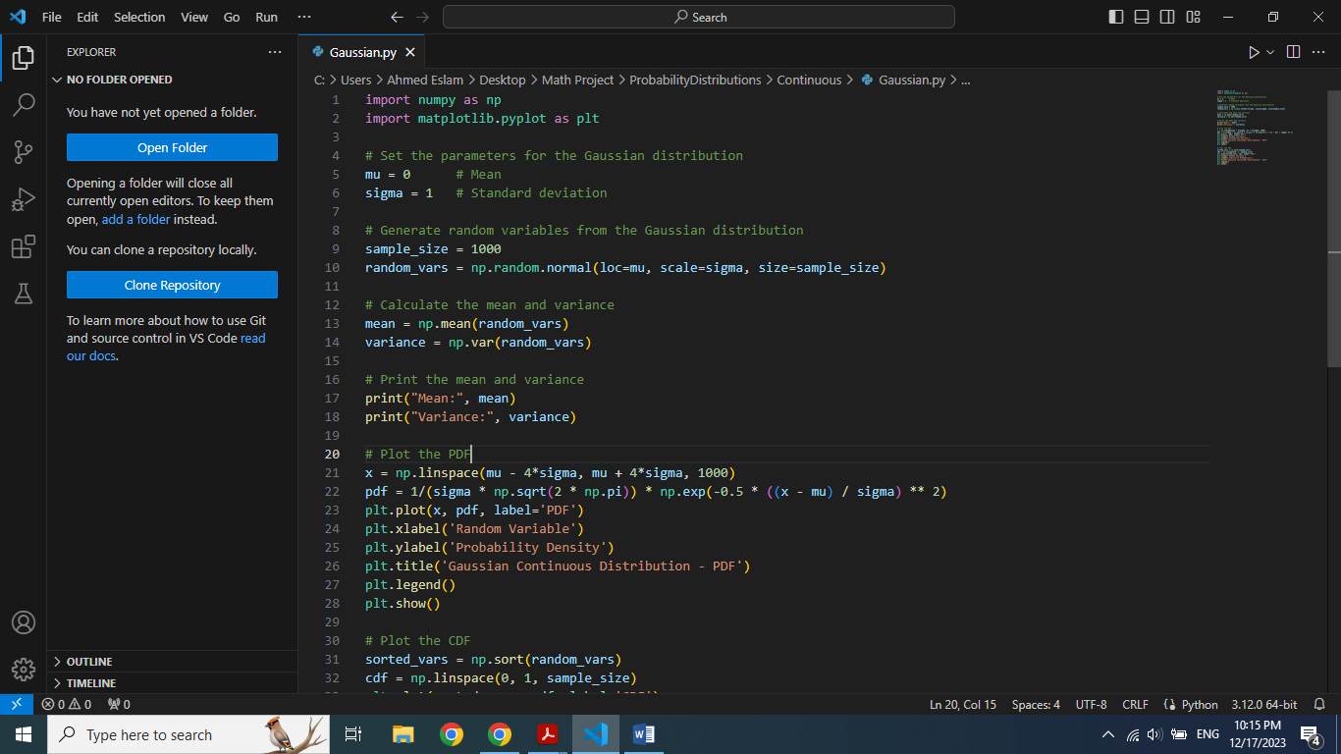
Gaussian Distribution:
Code:
First, we import the needed libraries:
Second, we set the
parameters for Gaussian
Distribution:
Third, we calculate and print
Mean and Variance:

Slide 44
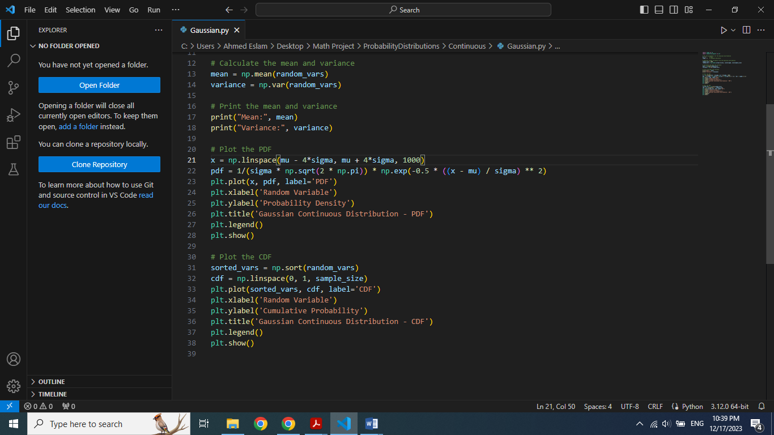
Gaussian Distribution:
Code:
Fourth, this block plots Probability
Density Function (PDF):
Finally, this block plots Cumulative
Distribution Function (CDF):

Slide 45
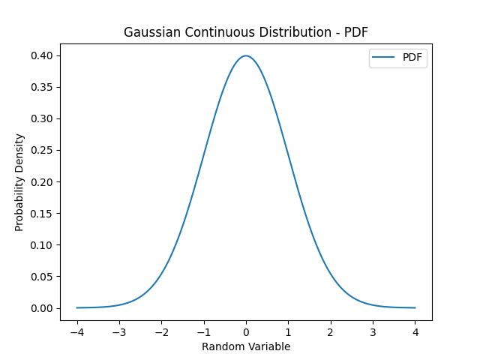
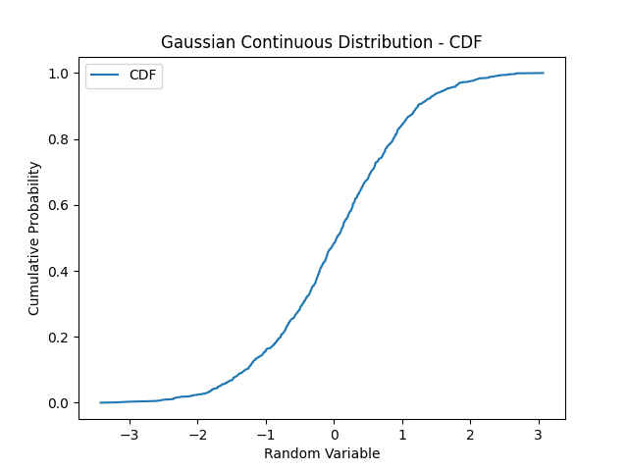
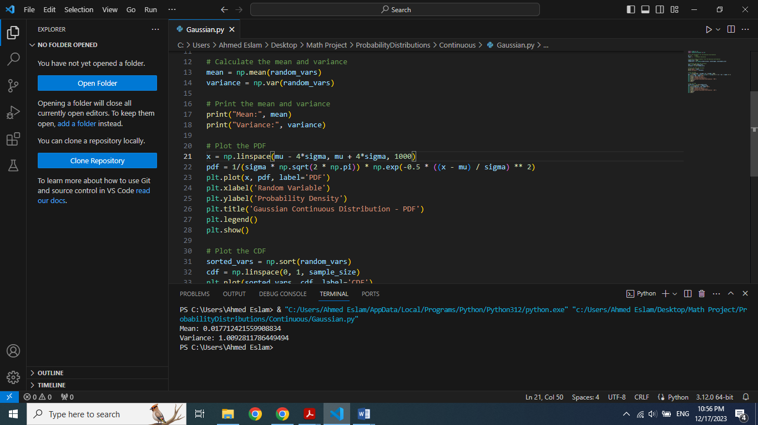
Gaussian Distribution:
Output:
Mean
and Variance
PDF Plot
CDF Plot

Slide 46
Thank You For
Your Attention

